Slide 1


Minor Project
Title: ARES - Autonomous Reliability Engineering System
AI-Powered Self-Healing Microservices Platform for Cloud Applications
Presented by:
R2142231379 –Nitanshu Tak
R2142230722 –Aakriti Dhawan
R2142230892 –Sristee Bhindwar
R2142230888 –Aarohi Jaiswal
Mentored By: Mr. Abhishek Roshan

Slide 2
Content
🔹 Introduction
Overview of ARES, its purpose, and the need for autonomous reliability in modern cloud systems.
🔹 Literature Review
Study of existing work in Site Reliability Engineering, self-healing systems, and ML-based anomaly detection.
🔹 Objectives
Goals of building a self-healing, AI-driven microservices platform with automated monitoring and recovery.
🔹 Methodology
System architecture, tools used, DevOps pipeline, agent framework, ML integration, and self-healing workflow.

Slide 3
Introduction
Technical Concepts (Algorithms) Used
- Microservices architecture
- Docker containerization
- CI/CD automation
- Monitoring & metrics analysis
- ML anomaly detection (Isolation Forest)
- Self-healing recovery logic
Area of Application
- E-commerce platforms
- Streaming services like Netflix
- Banking systems
- SaaS cloud platforms
Motivation
- Cloud apps fail due to traffic spikes, crashes, and resource overload. - ARES enables automatic detection and recovery without human intervention.
Problem Statement
- Build a cloud system that can:
- Detect failures
- Predict anomalies
- Recover services automatically
- Reduce downtime
Dataset and Input Format
- System metrics used:
- CPU usage
- Memory usage
- Response time
- Service health logs

Slide 4
Literature Review
Cite Related Work
Research in Site Reliability Engineering (SRE) focuses on maintaining system uptime through monitoring, alerting, and incident management, but recovery often depends on human intervention.
Self-healing and autonomic computing introduce systems that can detect failures and trigger automated responses using control loops like MAPE-K.
Modern observability tools (Prometheus, ELK, Grafana) provide system visibility but mainly generate alerts rather than executing recovery.
Recent work in ML-based anomaly detection uses models like Isolation Forest to identify abnormal system behavior, improving failure prediction.
Research Gap
Most existing systems can monitor or predict issues, but they lack integration with autonomous decision-making and automated healing.
ARES bridges this gap by combining monitoring, ML-based anomaly detection, and self-healing actions into one unified reliability platform.

Slide 5
Literature Review
SWOT Analysis
Strengths
Integrates microservices, DevOps automation, and ML-driven anomaly detection into a unified reliability platform. Implements autonomous self-healing using monitoring agents, decision logic, and container-level recovery actions. Scalable cloud-native architecture with CI/CD, observability stack, and fault isolation.
Weaknesses
High system complexity due to multi-layer integration (ML, agents, microservices, monitoring). Performance depends on accurate anomaly detection models and sufficient cloud resources.
Opportunities
Foundation for AIOps, autonomous cloud infrastructure, and next-generation SRE systems. Applicable to high-availability domains like SaaS, fintech, streaming, and distributed platforms.
Threats
Incorrect ML predictions may trigger improper recovery actions. Security and stability risks in automated remediation of distributed systems.

Slide 6
Objective
Main Objective: To design and implement a cloud-native self-healing application platform that:
- Continuously monitors system performance
- Detects failures and anomalies automatically
- Uses ML to identify abnormal behaviour
- Executes recovery actions without human intervention
- Minimizes downtime and improves system reliability

Slide 7
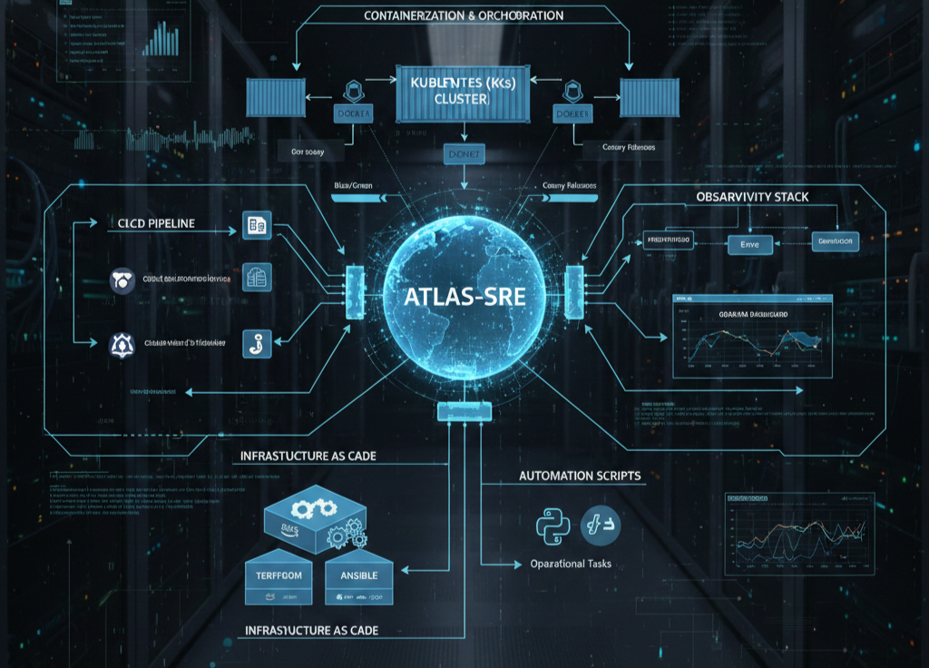
Methodology
Reference Software Model
ARES follows an Autonomous Reliability Model:
Monitor → Analyze → Detect → Decide → Heal → Log
This model enables continuous system observation and automatic recovery.
Steps
- Develop SaaS microservices application
- Containerize services using Docker
- Set up CI/CD pipeline for deployment
- Implement monitoring agents
- Train ML anomaly detection model
- Integrate self-healing logic
- Test using load and failure scenarios
Timeline
Phase 1 — Application development
Phase 2 — Microservices & containers
Phase 3 — CI/CD & cloud deployment
Phase 4 — Agent monitoring system
Phase 5 — ML integration

Slide 8
Reference
1. On Microservices & Cloud-Native Architecture
- These papers provide the theoretical backing for why you chose a microservices approach for fault isolation.
- Dragoni, N., et al. (2017). "Microservices: Yesterday, Today, and Tomorrow." * Why: A foundational text that explains the transition from monoliths to microservices, emphasizing independent deployability and scalability—key themes of your Layer 1.
- Lewis, J., & Fowler, M. (2014). "Microservices: A definition of this new architectural term."
Why: While technically a detailed article/whitepaper, it is the industry-standard definition used in academic citations to justify microservice patterns.
2. On Self-Healing & Autonomic Computing
- Since ARES is an "Autonomous Reliability Engineering System," you are essentially implementing an IBM MAPE-K loop (Monitor-Analyze-Plan-Execute).
- Kephart, J. O., & Chess, D. M. (2003). "The Vision of Autonomic Computing." (IEEE Computer).
Why: This is the most famous paper on self-healing systems. It introduces the idea of systems that manage themselves based on high-level objectives.
- Weyns, D. (2017). "Software Engineering of Self-Adaptive Systems."
Why: Provides a roadmap for how agents (like your Healing and Health agents) can systematically adapt to environment changes.

Slide 9
Reference
3. On ML-Based Anomaly Detection
- Your use of Isolation Forests or threshold models for system metrics is a hot topic in "AIOps."
- Liu, F. T., Ting, K. M., & Zhou, Z. H. (2008). "Isolation Forest." (IEEE International Conference on Data Mining).
Why: Since you mentioned Isolation Forest in Section 7, citing the original creators of the algorithm is essential.
- Chandola, V., Banerjee, A., & Kumar, V. (2009). "Anomaly Detection: A Survey." (ACM Computing Surveys).
Why: A massive, highly-cited overview that justifies why you chose specific detection methods for system logs and metrics.
4. On Reliability & Chaos Engineering
- Your project uses load testing (Locust) and manual service killing to prove reliability, which is the core of Chaos Engineering.
- Basiri, A., et al. (2016). "Chaos Engineering." (IEEE Software).
Why: Written by the team at Netflix, this paper defines the discipline of "experimenting on a distributed system in order to build confidence in the system’s capability to withstand turbulent conditions."
- Heorhiadi, V., et al. (2016). "Gremlin: Systematic Resilience Testing of Microservices."
Why: Focuses specifically on testing microservice failures, which mirrors your "Final Project Demo Flow."

Slide 10
Thank You

